Slide 1



Investigate Perceptions
of anti-Hindu hate in the UK
Report, October 2025
BY Ornicha Daorueng, Head of Future of Faith Desk

Slide 2

What we investigated
Key Context
Nature and extent of anti-Hindu hostility
How hostility manifests (media, social media, education)
What constitutes anti-Hindu discrimination
Whether incidents are under-reported
1 million Hindus in the UK
Hindus ranked 5th in religious hate crime (2023–24)
After Muslims (3,678), Jews (3,282), Christians (603), and Sikhs (216)
Low numbers: low hostility, or under-recognition?
Research approach
Survey of Hindu communities | Media & external reports
National hate crime data | Educational institutions

Slide 3
Key Findings
Lack of definition & institutional mechanism
Clear definitions are essential to identify, monitor, and address hate
The UK recognises and records antisemitic and anti-Muslim hate (CST, Tell MAMA)
No equivalent definition or reporting mechanism for anti-Hindu hate
Policy implications
Vicious Cycle
Low data → No recognition
→ No policy mechanism → Low data
No clear policy guidance
No dedicated police reporting protocols
No recognised national monitoring body
Results
Hate incidents treated as isolated acts of violence
Experiences remain within communities, not in wider public discourse

Slide 4

Anti-Hindu Hate Monitor
Filling the reporting gap
A national portal to document anti-Hindu hate incidents
Open to those identifying with Hindu, Jain and Dharmic traditions

Slide 5
Anti-Hindu Hate Monitor
Purpose & approach
How it works
Monitor and collect real-world incidentdata
Developed in line with CST and TellMAMA models
Consultation with CST best practices
Community members report incidents through the portal
We document, analyse, and publish findings
Focus on monitoring and documentation
(not victim support)
Outcome
Evidence-based reports for engagement with:
Home Office | Police | Local authorities | Media | Wider Public

Slide 6


Slide 7
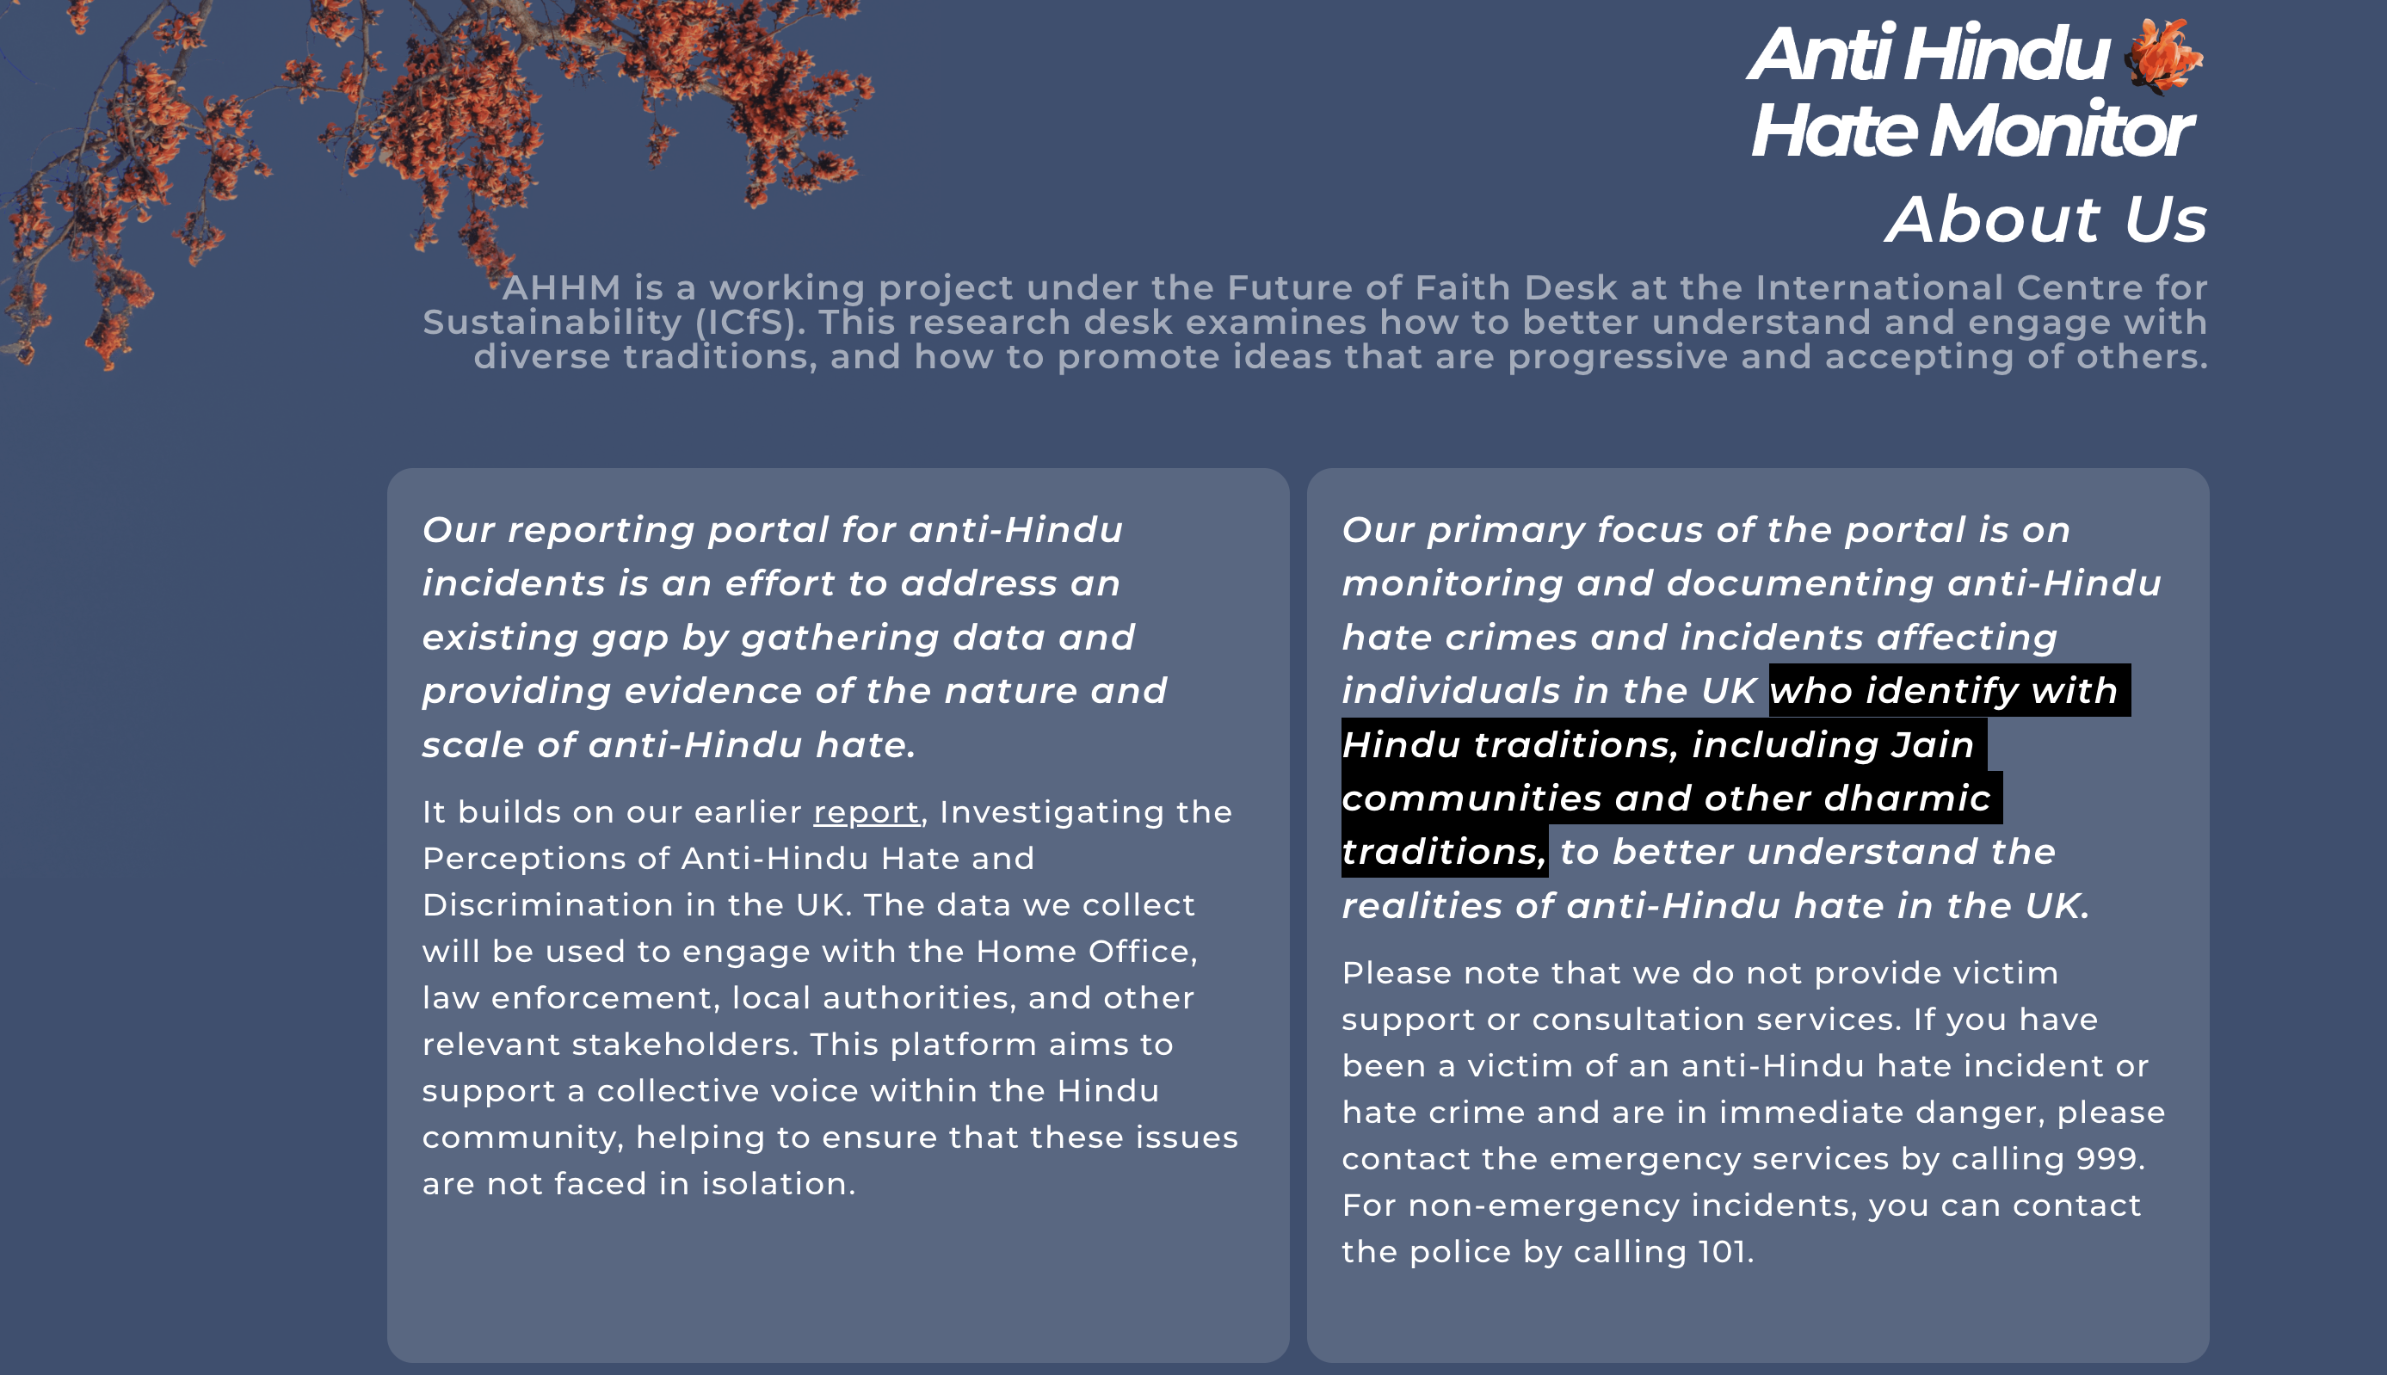

Slide 8
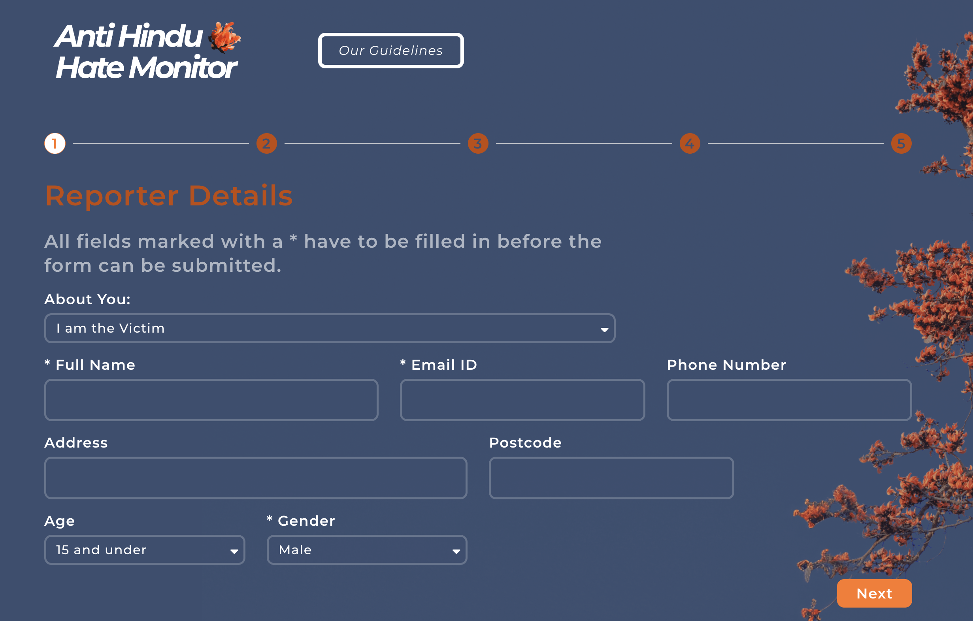

Slide 9
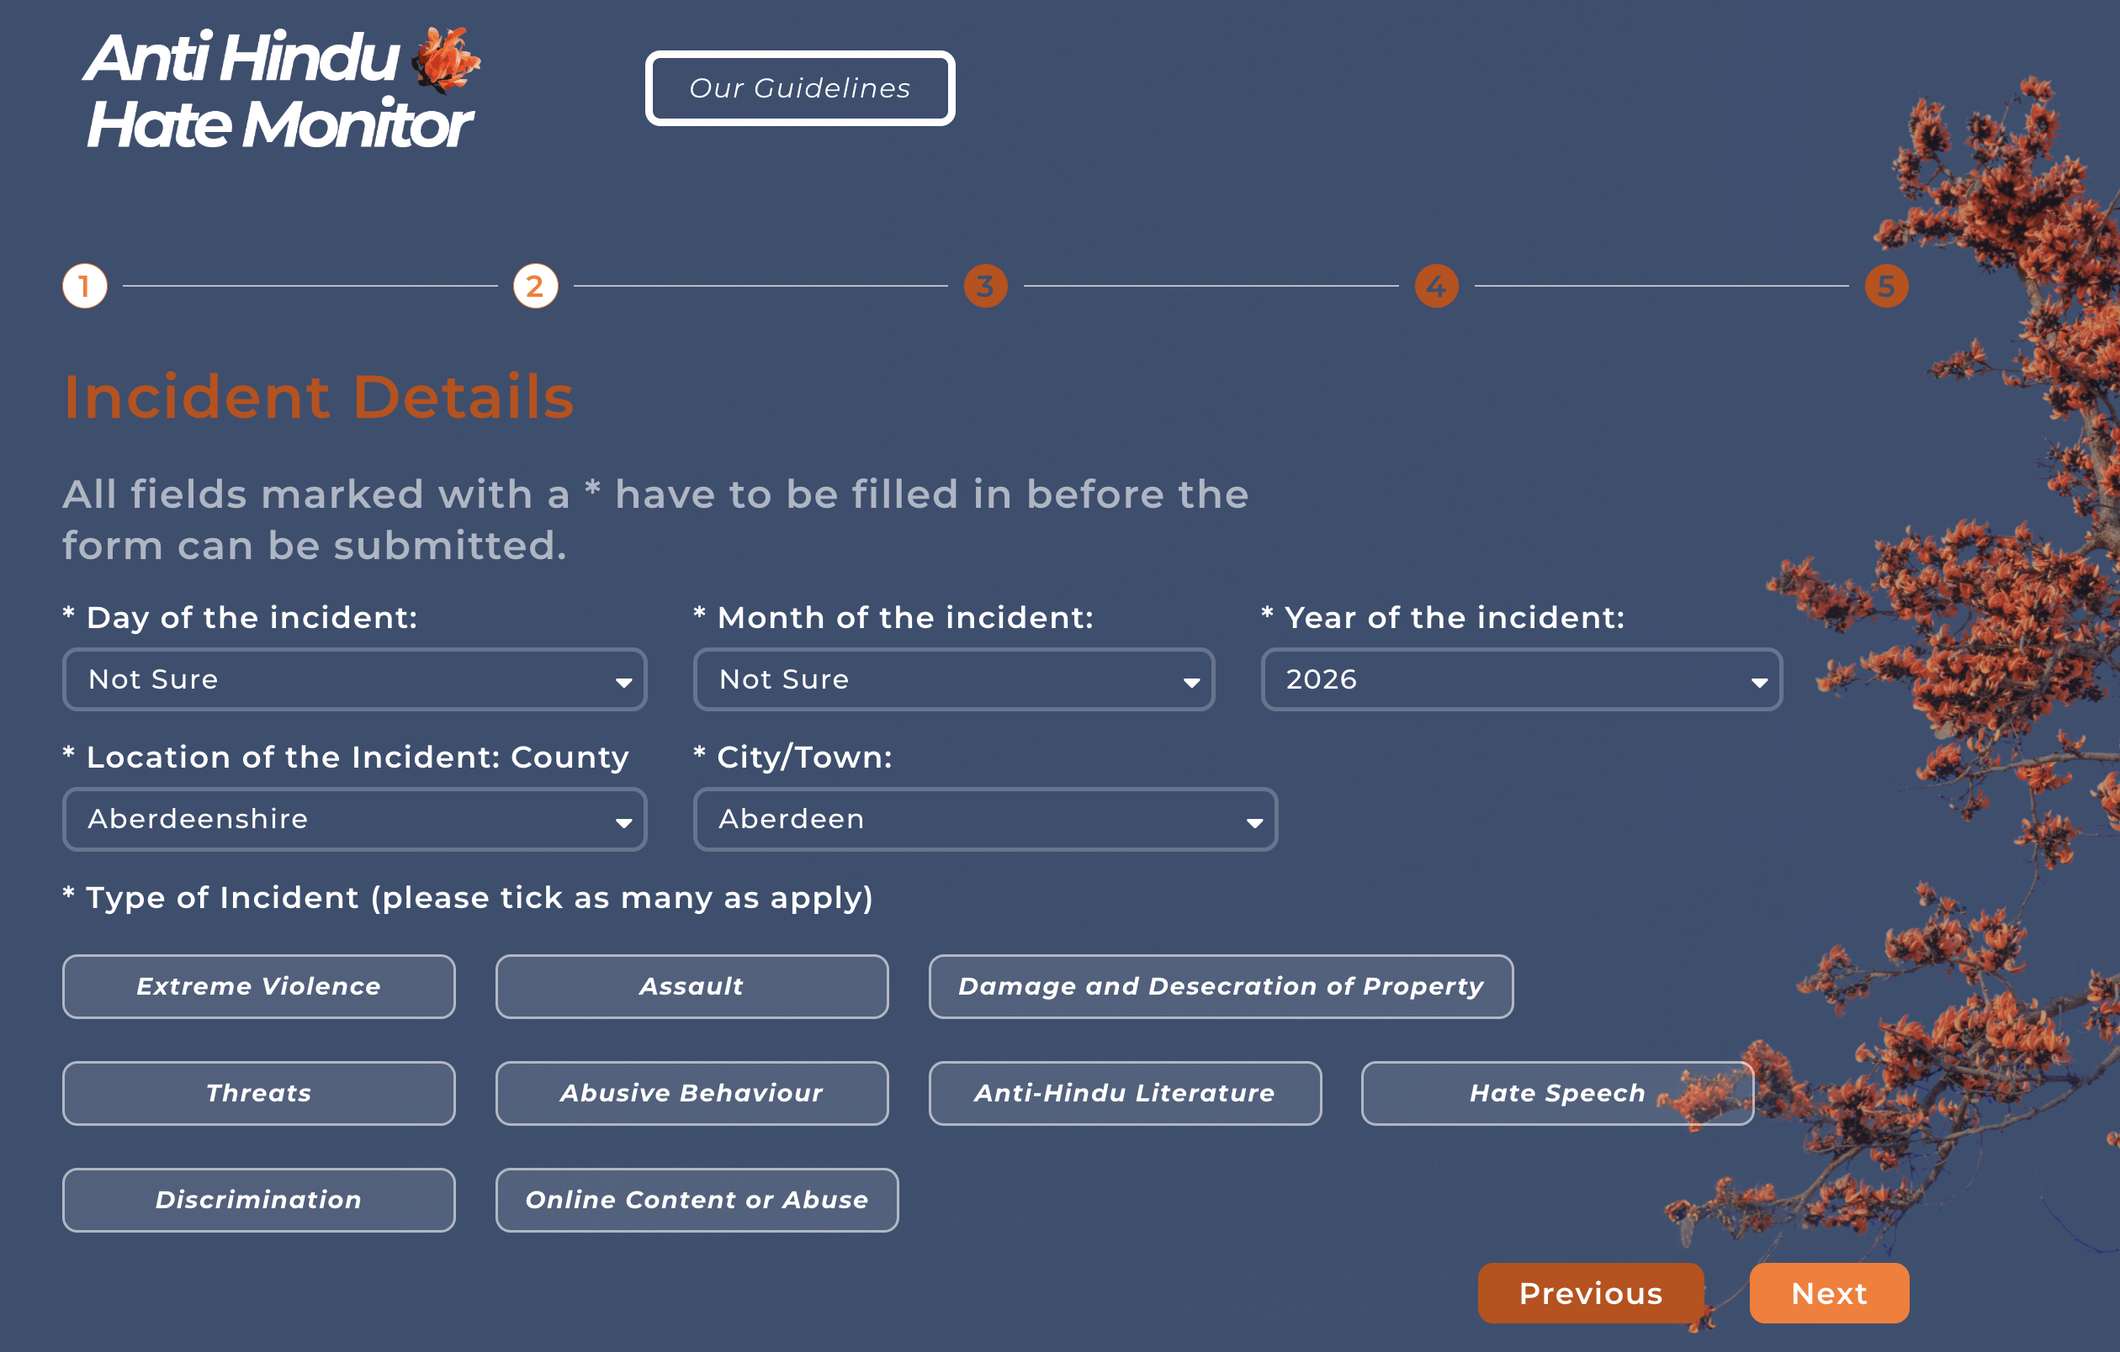

Slide 10
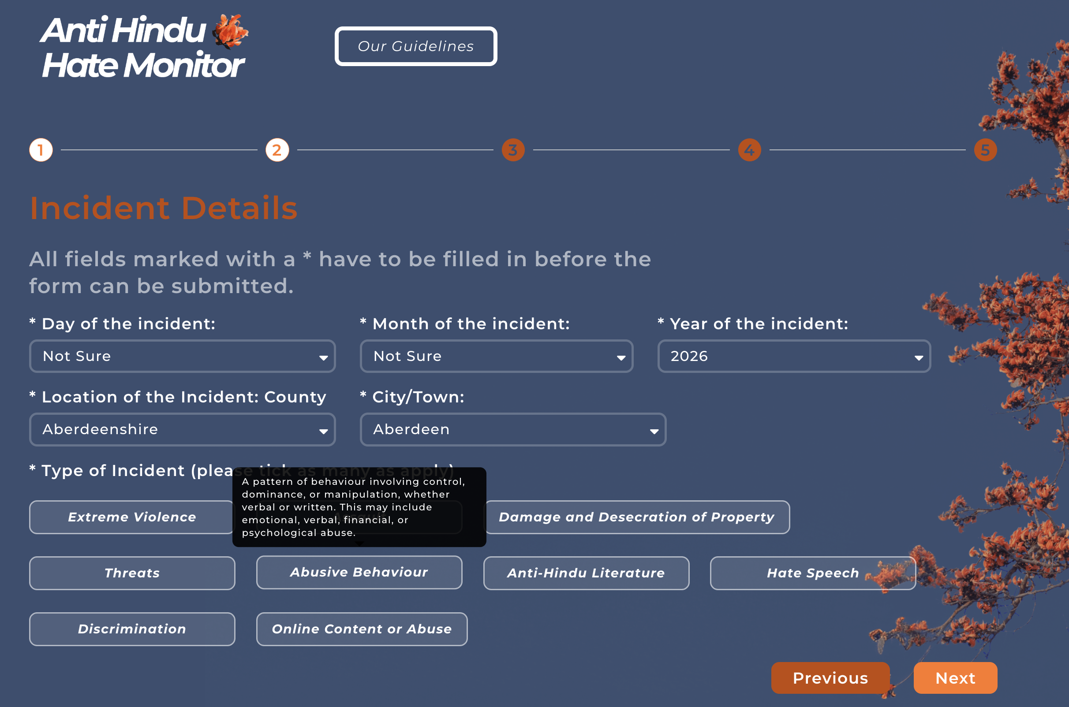

Slide 11
Strengthening Jain Voices Through Data
This portal is for all Dharmic traditions
For Hindus, Jains and other Dharmic communities
Perpetrators often do not distinguish between traditions
— they see only “Dharmic”
From experience to evidence
Community reporting
→ stronger data
→ clearer understanding
→ better response from authorities
Stronger engagement through data
Evidence-based reports to engage with Home Office, police, local authorities and media
Fragmented or low data weakens recognition of the issue
A channel for Jain individuals and communities
Report and share experiences
Bring incidents into public and national discourse

Slide 12
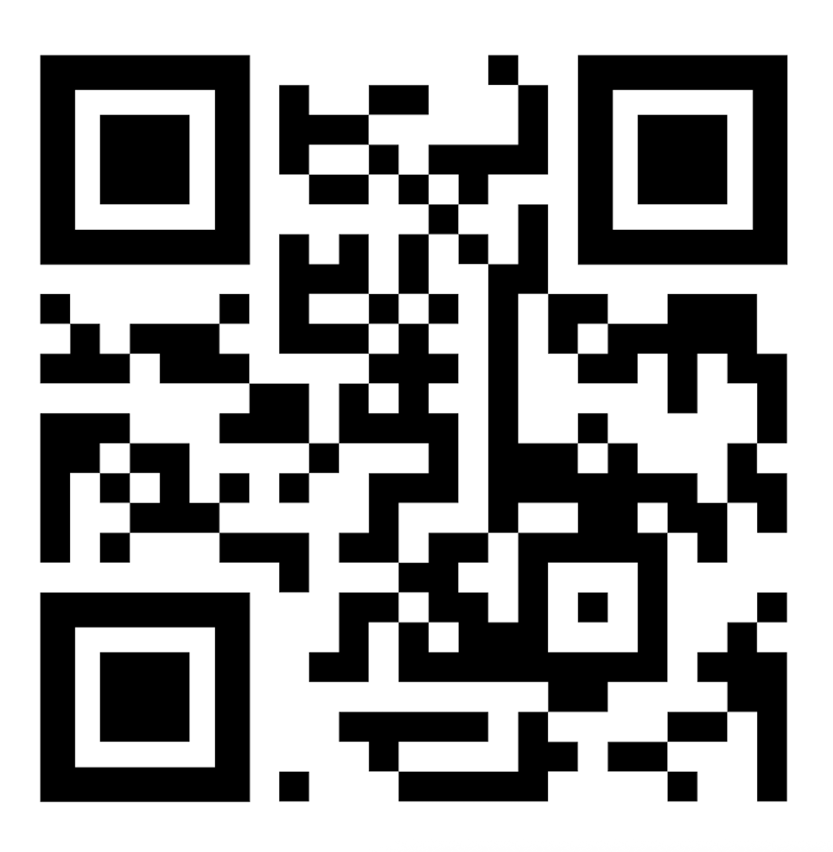
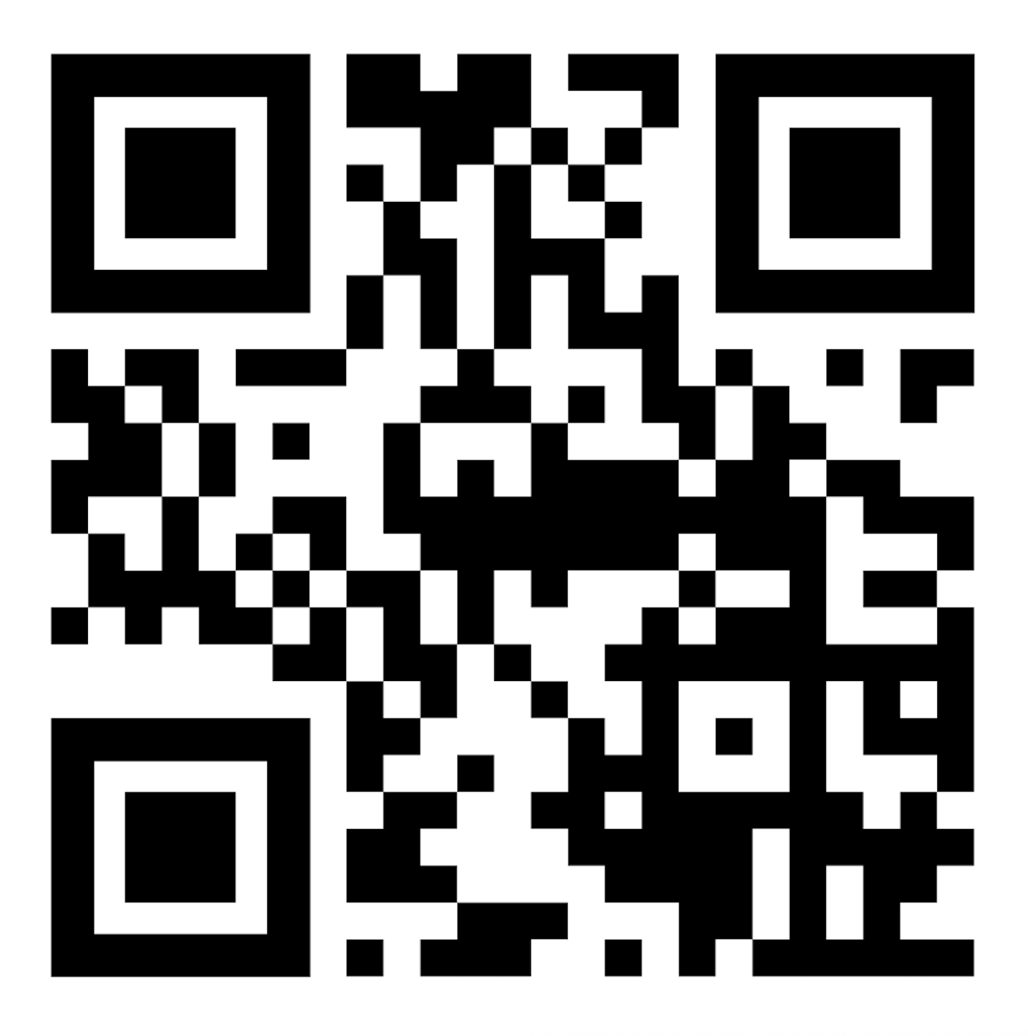
THANK YOU
Read the Report
ICfS LinkedIn

