Slide 1



OneJAIN Conference 2026
Supporting the UK Jain Community

Slide 2
Welcome - OJ Conference 2026!
About OneJAIN
Membership
2025 in pictures

Slide 3
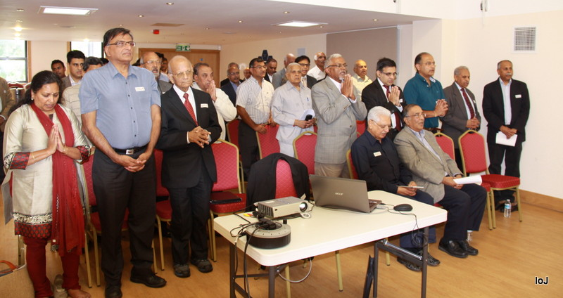
2014 – A historic year for Jain unity

Slide 4
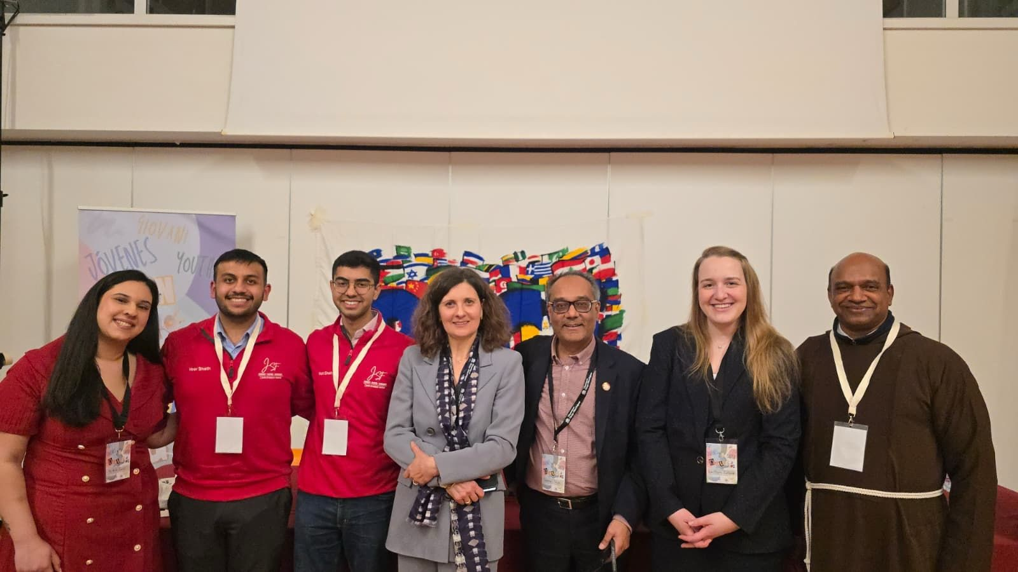
Focus Areas
Promote Jain community and Jain faith
Government relations
Interfaith dialogue
Museums, Libraries, Collections
Universities, education

Slide 5
OneJAIN Membership
Panel
4 OneJAIN members
IOJ Members
Member
Subscribed members
Student members
Associate
All other members

Slide 6
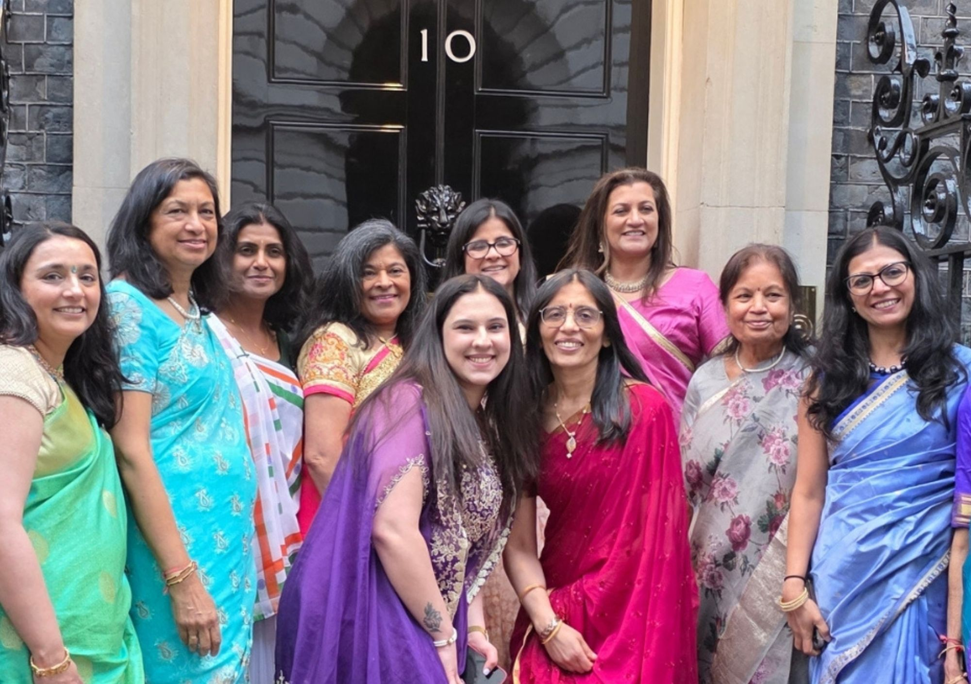
Mahavir Janma Kalyanak at No. 10

Slide 7
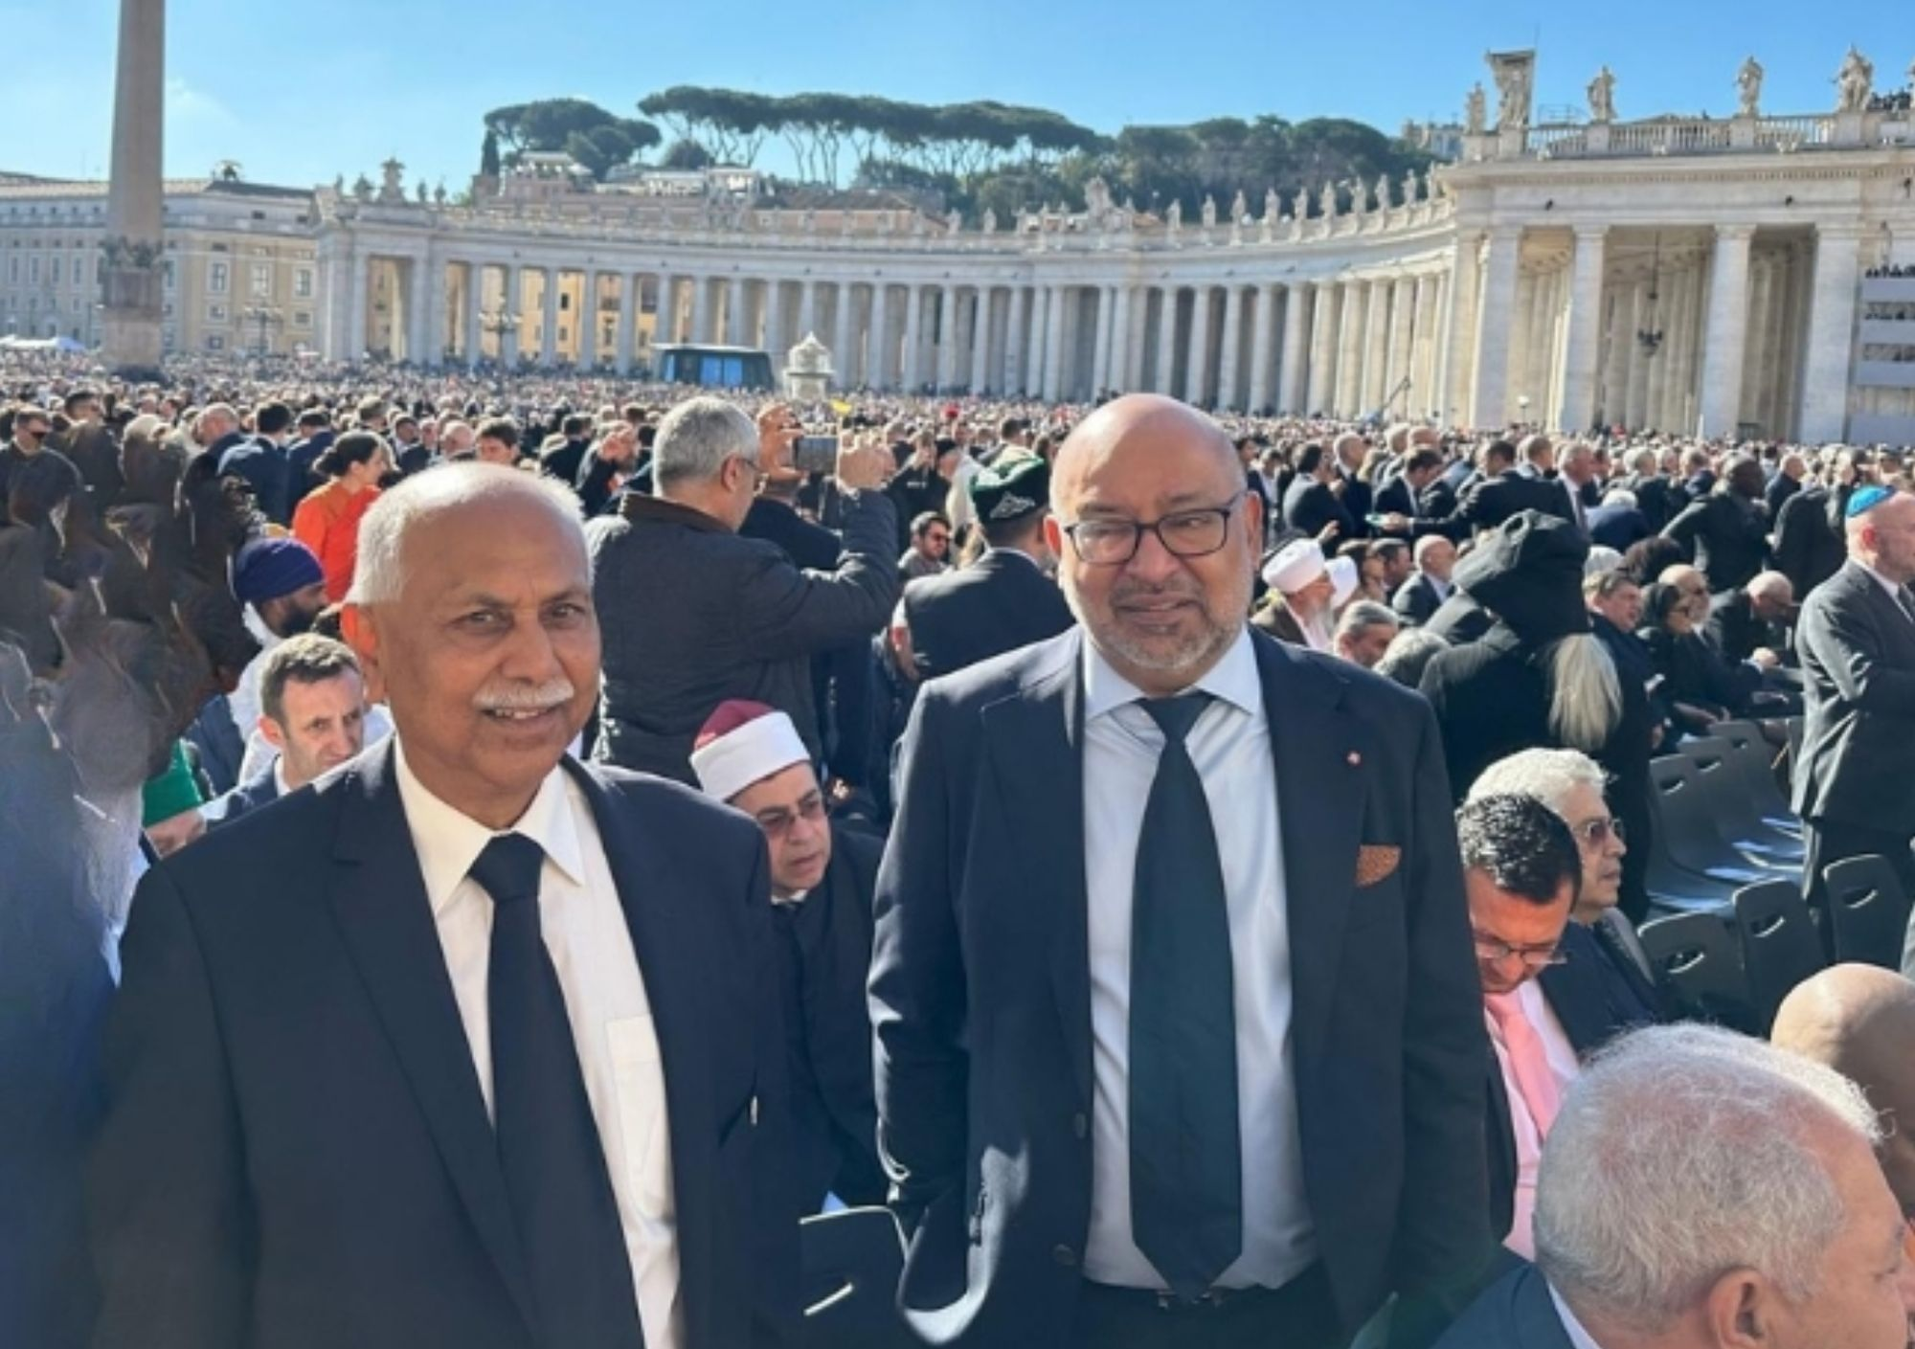
Passing of His Holiness Pope Francis

Slide 8
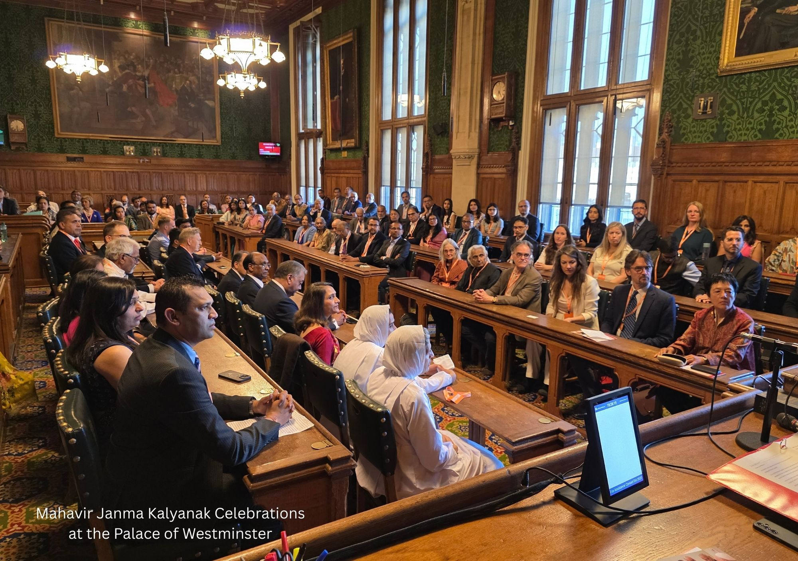
Mahavir Janma Kalyanak at the House of Commons

Slide 9
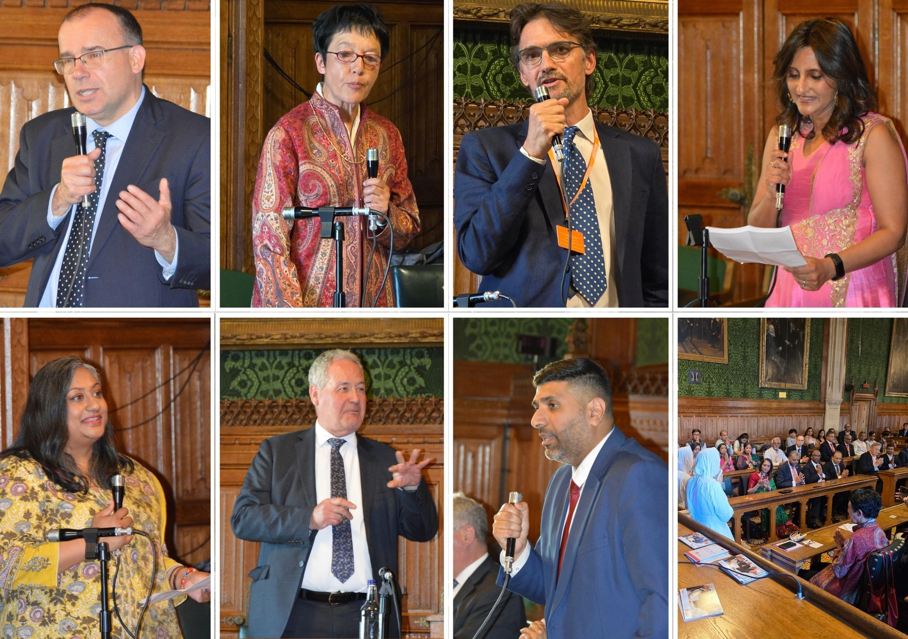
Mahavir Janma Kalyanak at the House of Commons

Slide 10
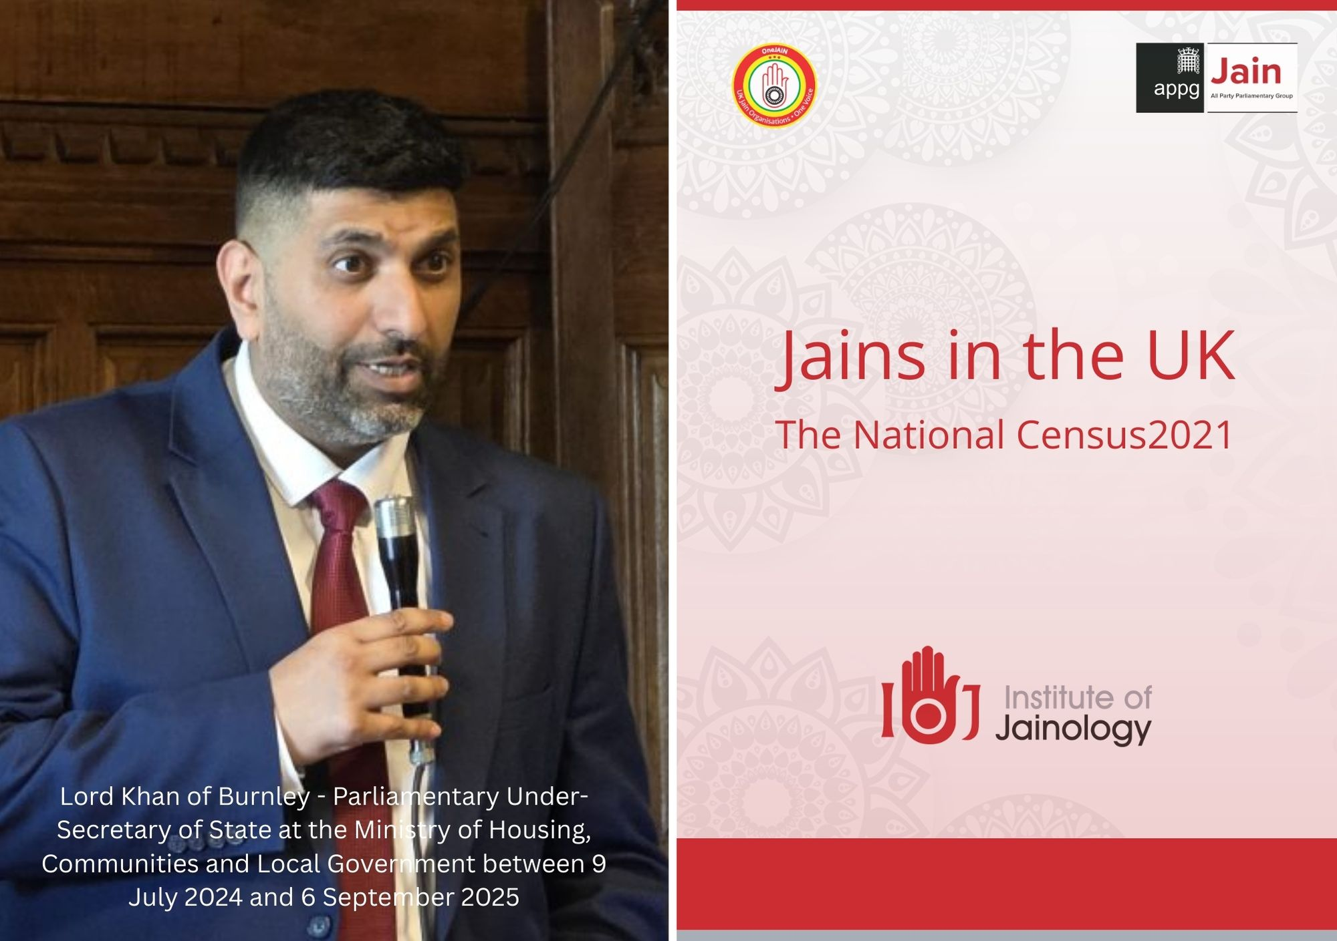
2021 Census Report on Jains in Britain

Slide 11
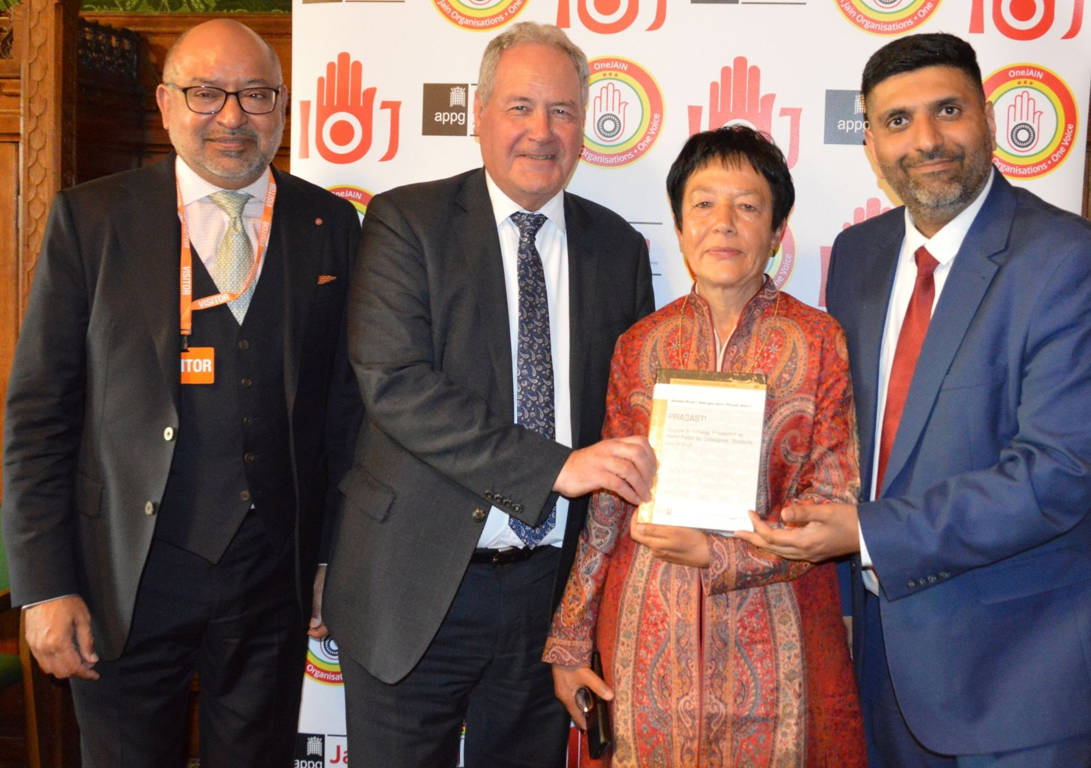
Felicitation of Professor Nalini Balbir

Slide 12
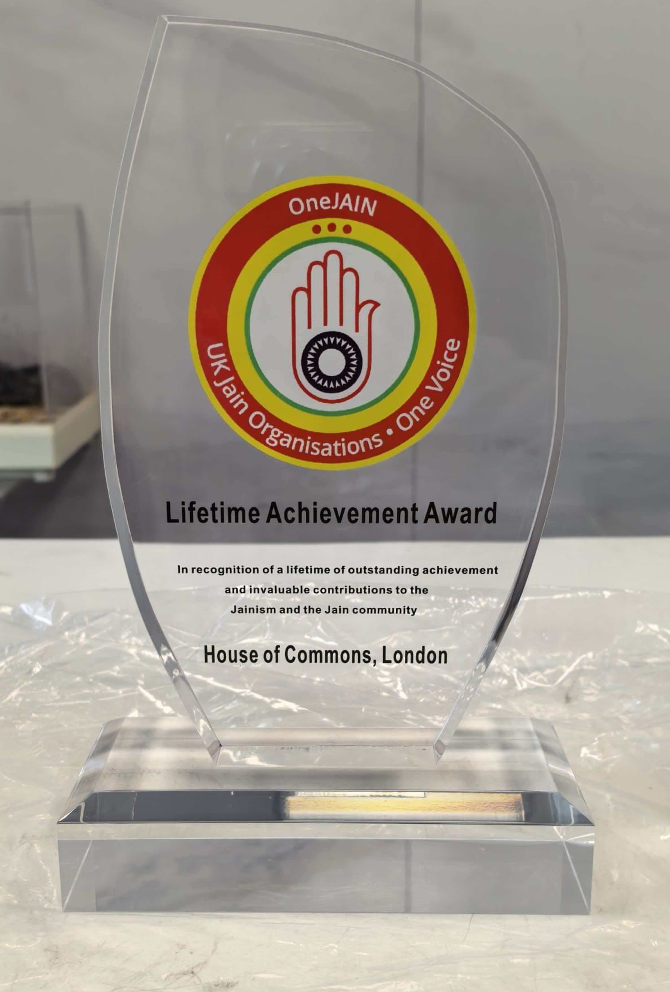

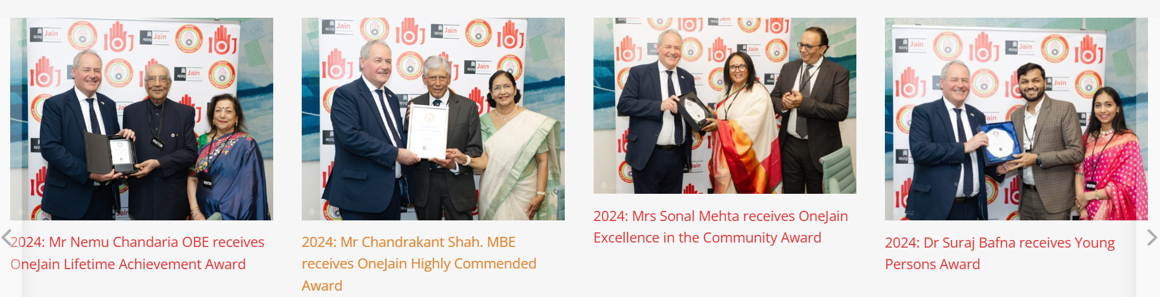
OneJAIN Awards

Slide 13
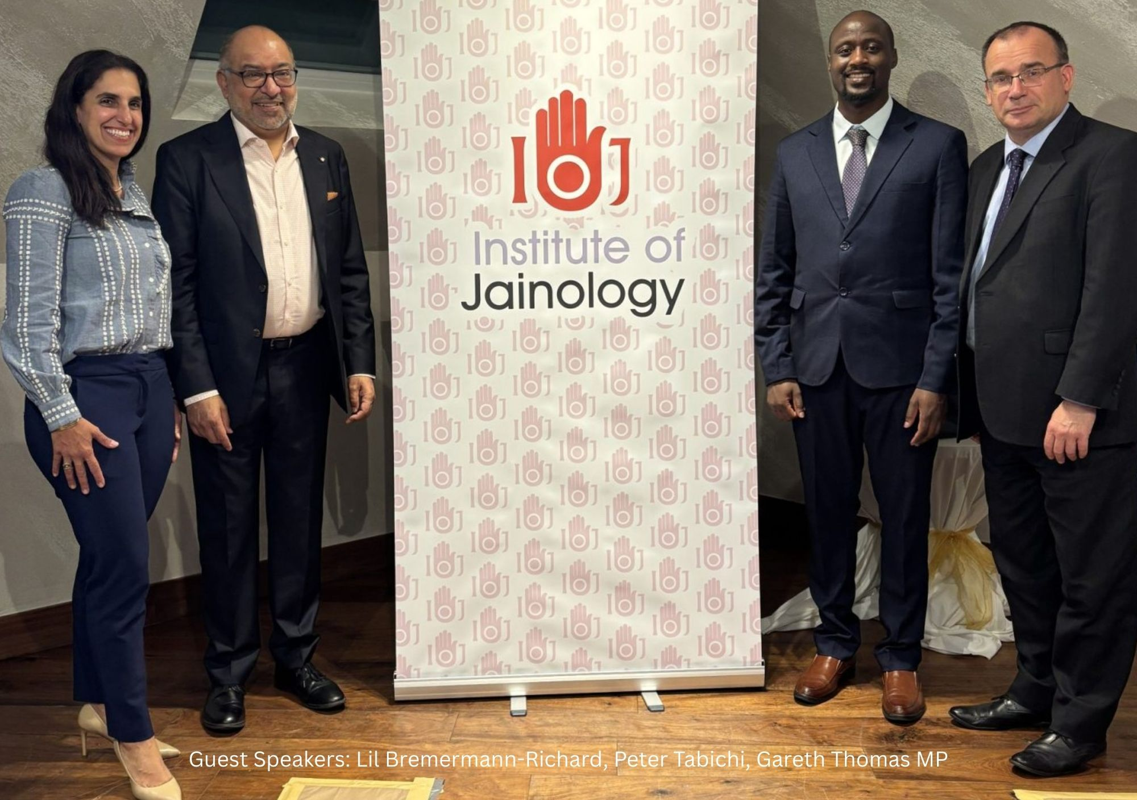
IOJ Patron's Dinner UK-India Trade and Innovation

Slide 14
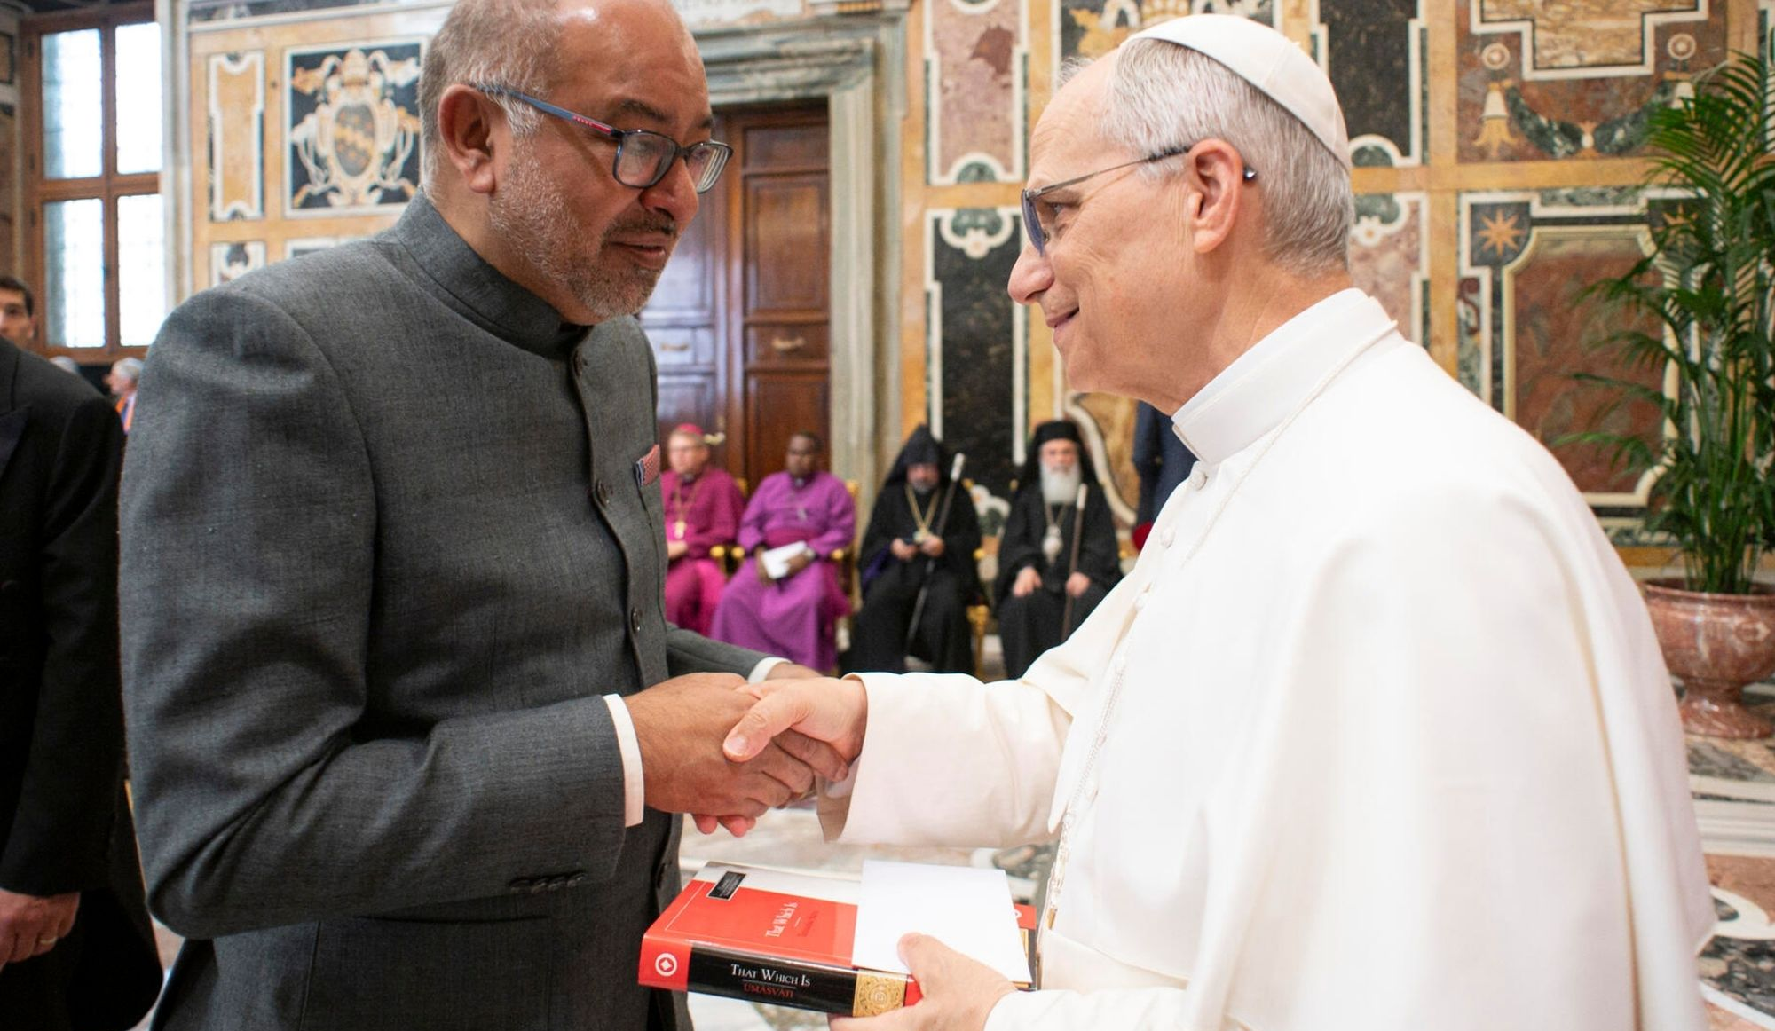
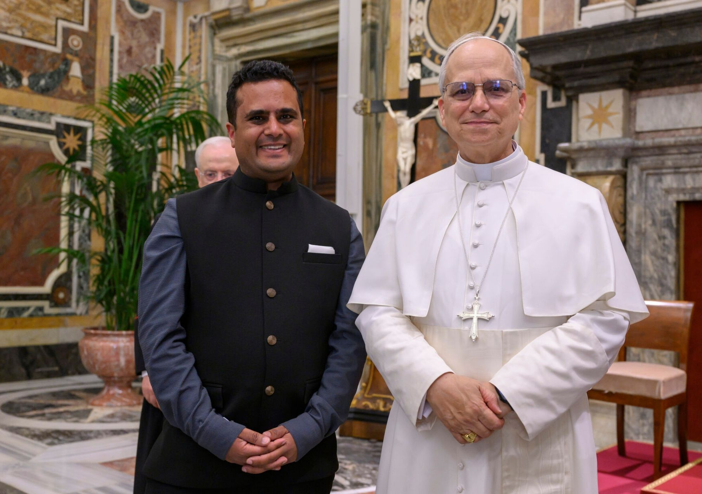
Inauguration of Pope Leo XIV

Slide 15
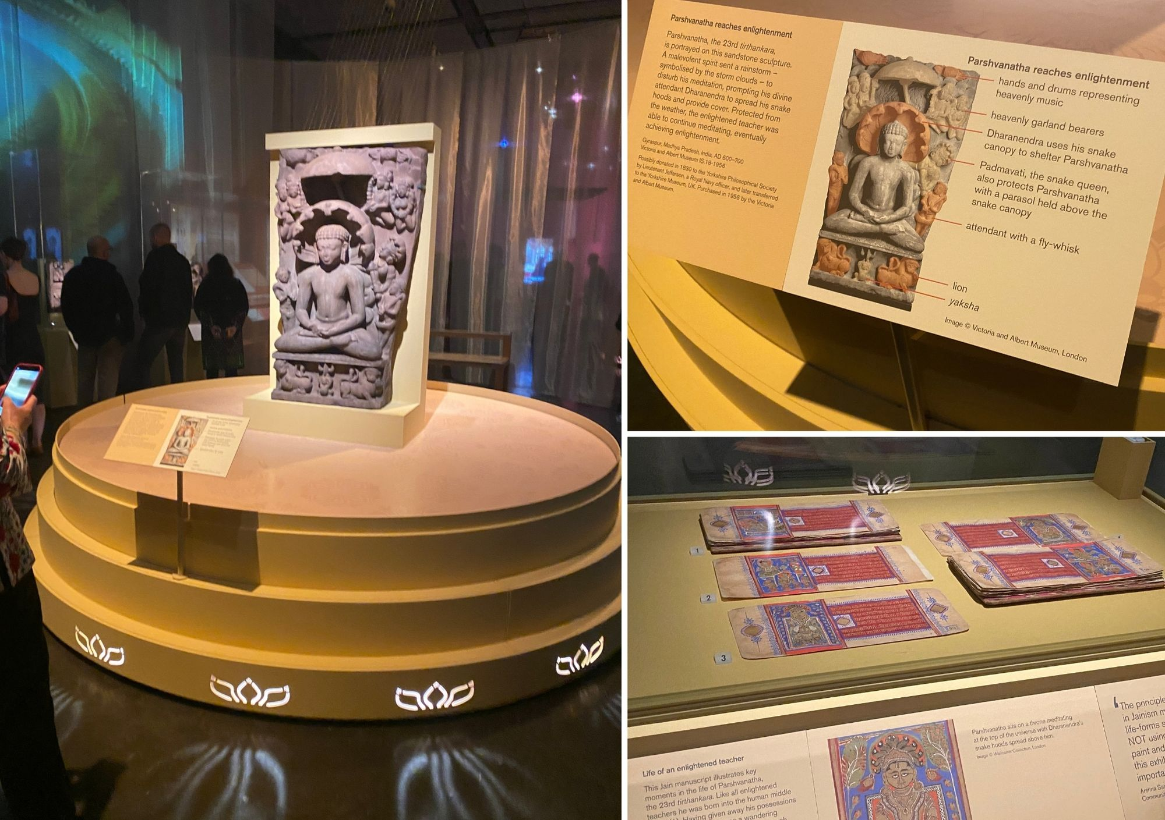
Ancient India: Living Traditions Exhibition

Slide 16
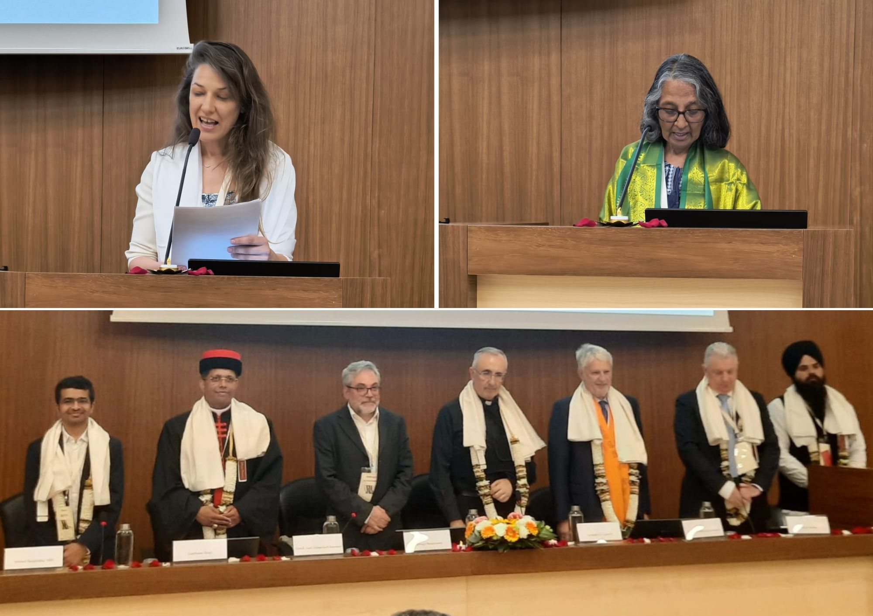
Vatican Conference: Re-igniting Hope

Slide 17
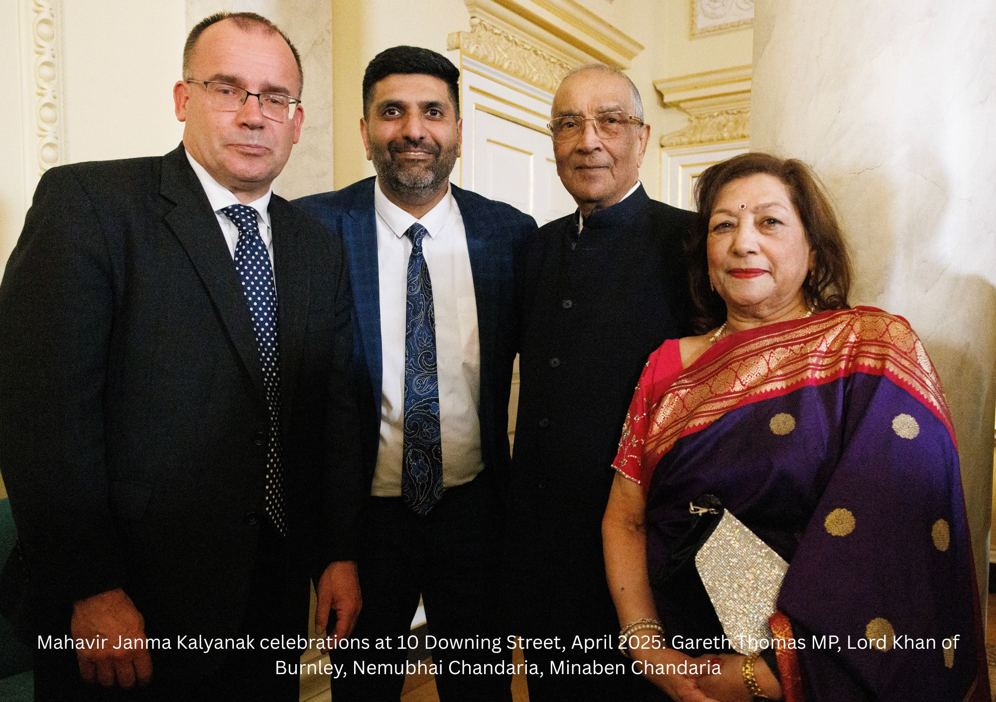
Shri Nemubhai Chandaria OBE (1939–2025)

Slide 18
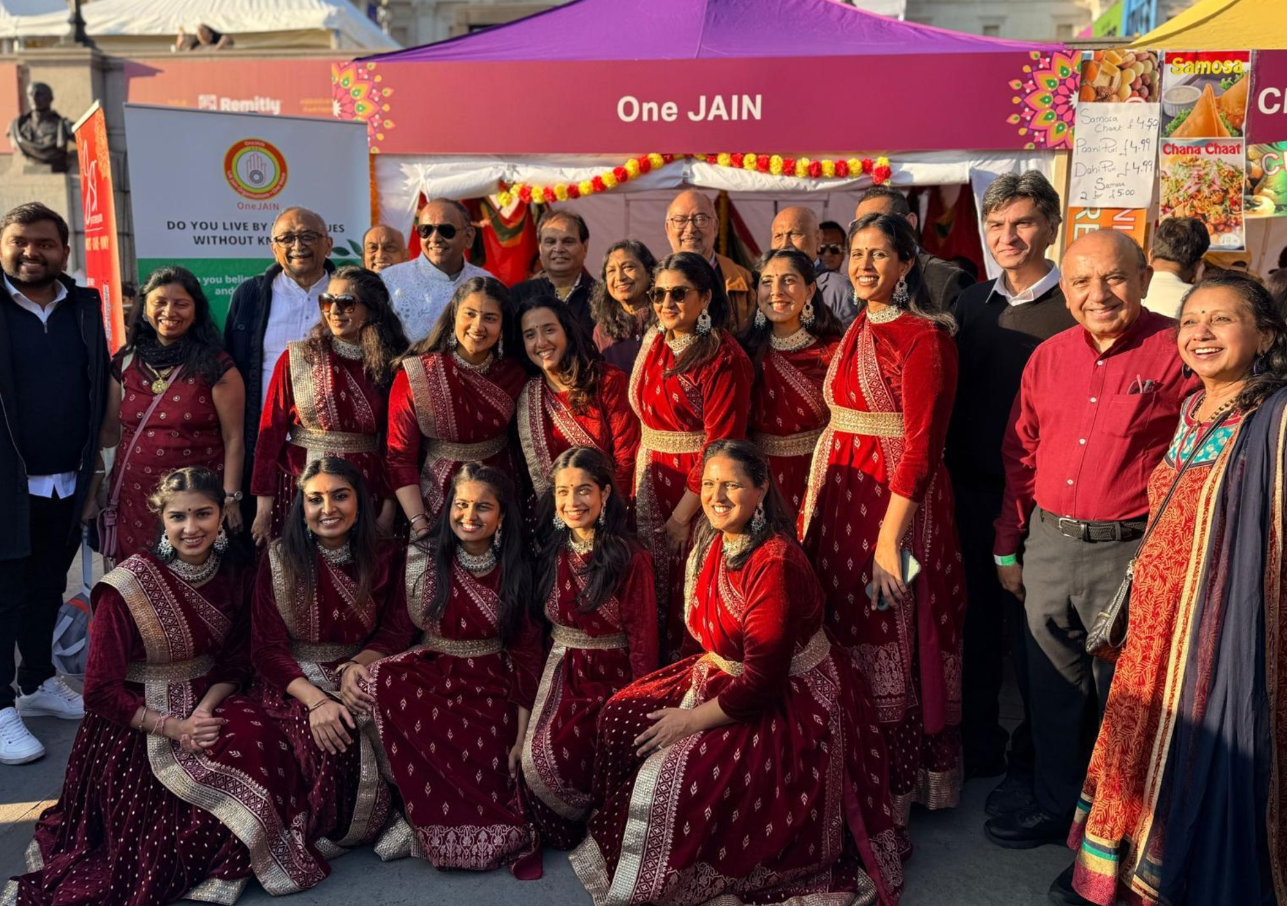
Diwali in Trafalgar Square

Slide 19
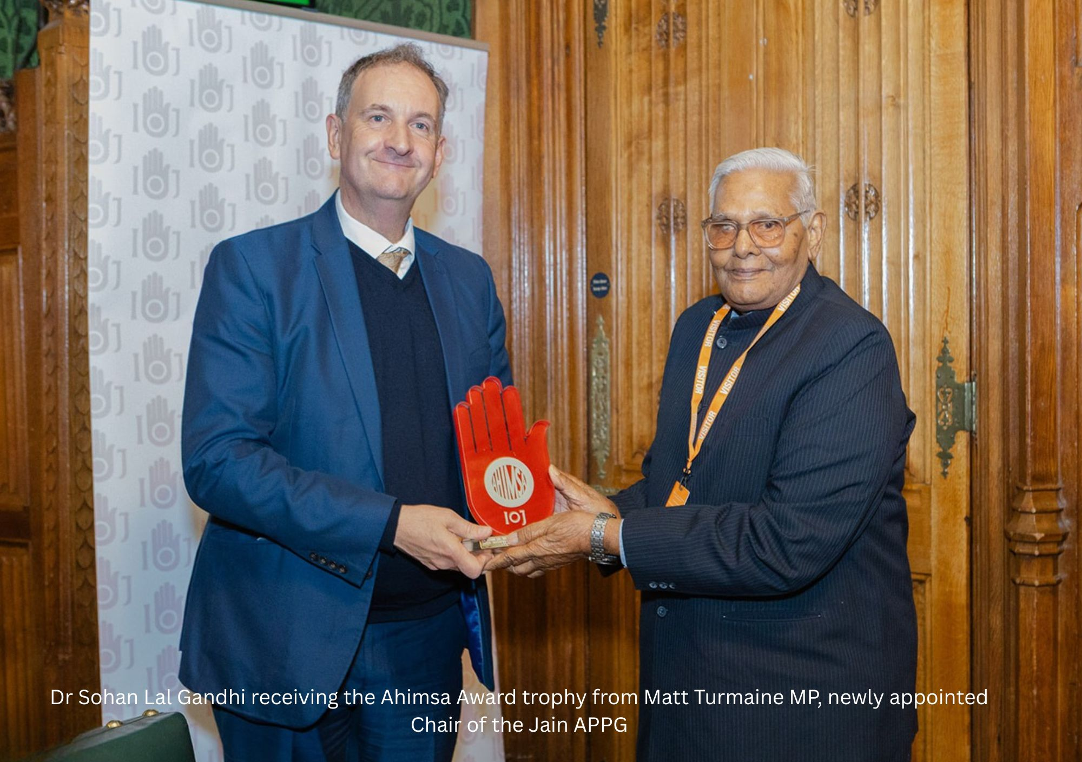
22nd Annual Ahimsa Day

Slide 20
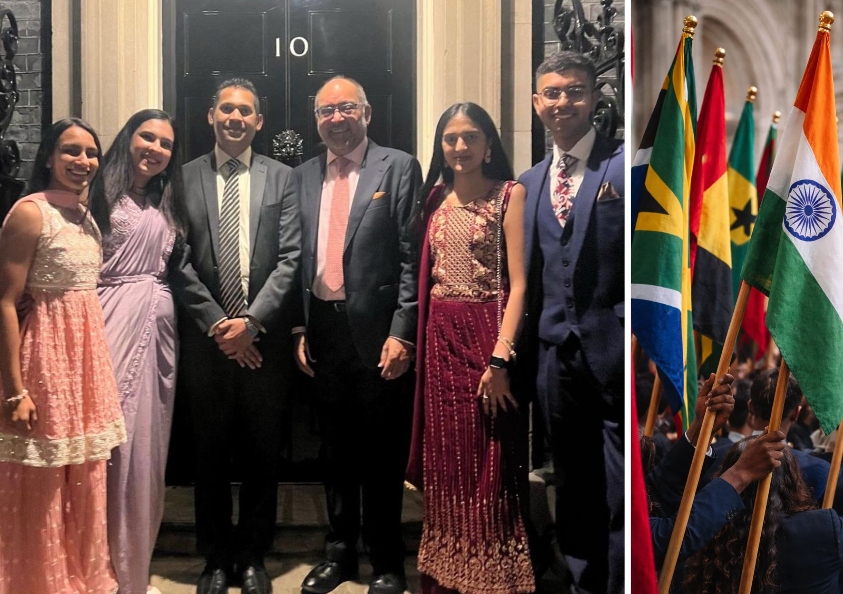
Celebrating Diwali at 10 Downing Street Commonwealth Day Service

Slide 21
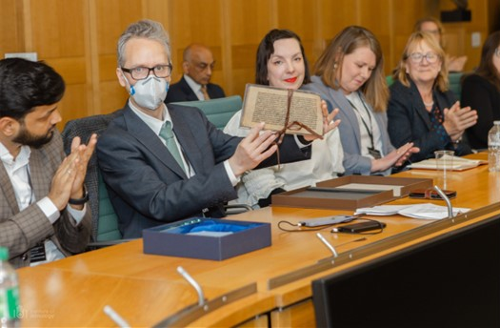
What’s our priority in 2026

Slide 22
OneJAIN Conference 2026
Supporting the UK Jain Community

Slide 23
OneJAIN Conference 2026
Supporting the UK Jain Community

Slide 24
Faiths in the UK
Christianity - 47%
Islam - 6.5%
Hinduism - 1.8%
Sikhism - 0.9%
Judaism - 0.5%
Buddhism - 0.5%
Jainism - c. 65,000 (0.1%)
Bahai
Zoroastrianism
*Best approximation

Slide 25
Major Jain migrations
1950s – 1980s East African migration
2000 – 2025 Indian migration

Slide 26
Community anchors before 2000
Joint family, multi-generational households
Faith based communities
Family business
Geographically together, centred around a community

Slide 27
The community post 2000
Drivers: cheap Telecom, Technology, Transport
Joint family => internationally distributed families
Faith based communities => own social networks
Family business => professional occupations
Geographically spread, cantered around the 3 Ts.

Slide 28
Jainism in 2026
35+ organisations
Ageing population
First migration wave, age 40-70 disengaged
Children out of the community
Second migration wave, active
Organisations linked to India increasing
Access to enormous Jain material online
~50% of Jains marrying outside the community

Slide 29
What is our future?

Slide 30
Why the Census is important
2011 – ~ 20,000 identified as Jain
2021 – 25,000 (+25%)
Where is the gap?
“Spiritual But Not Religious”
“Mixed Households”
Don’t follow an organised religion

Slide 31
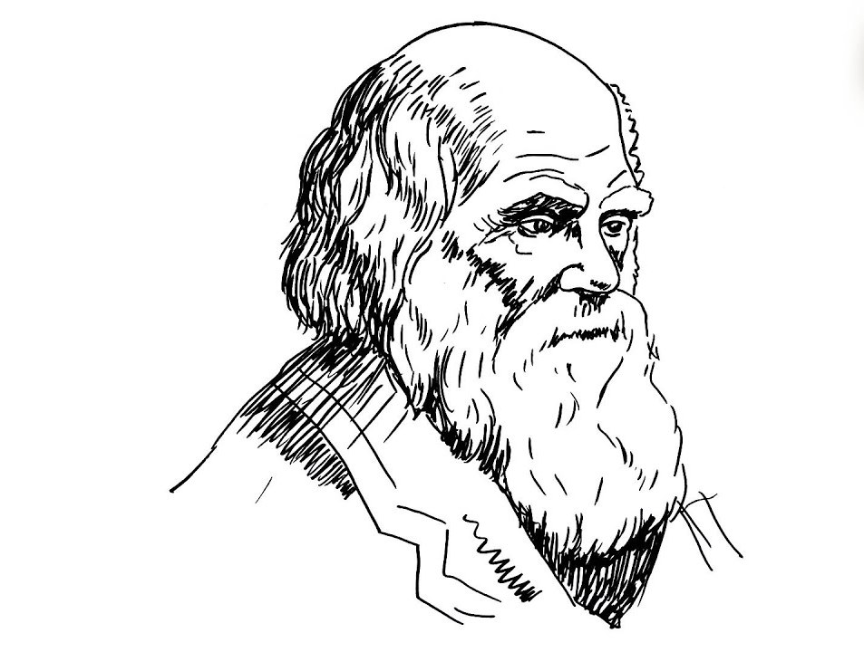
“It is not the strongest of the species that survives, nor the most intelligent, but the one most responsive to change.”

Slide 32
From Don'ts to Dos
Move away from Jainism’s current ‘food’ identity
Focus on Jain values
Make practices modern / practical
Focus on people proud of Jain identity

Slide 33
Change traditional Jain narrative
Ahiṃsā => stop violence to the planet (climate change)
Anekāntavāda => live with tolerance and diversity (stop the wars)
Aparigraha – live in harmony (stop the poverty)

Slide 34
Account for the new demographic
‘Jain’ welcoming ceremony for mixed couples
Festivals in English
Jain education
Jain identity (symbol)
Jain identity – schools / hospitals / govt

Slide 35
Students
Jain schools
Jainism in RE curriculum
Jain adult classes
Jainism at university
Jain Societies at Universities

Slide 36
OneJAIN Conference 2026
Supporting the UK Jain Community

