Slide 1
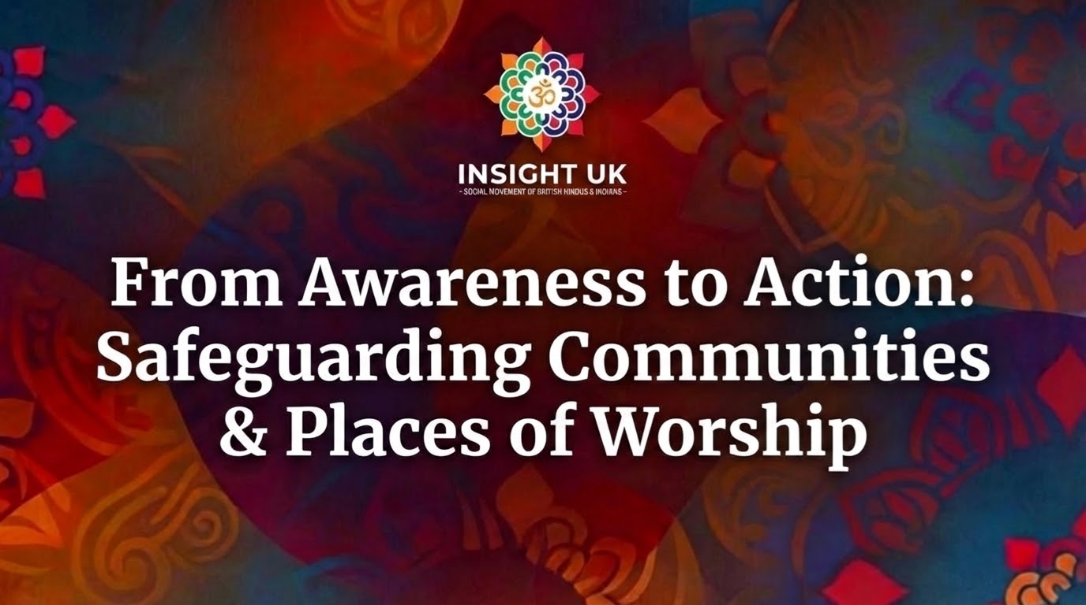

Slide 2


Slide 3
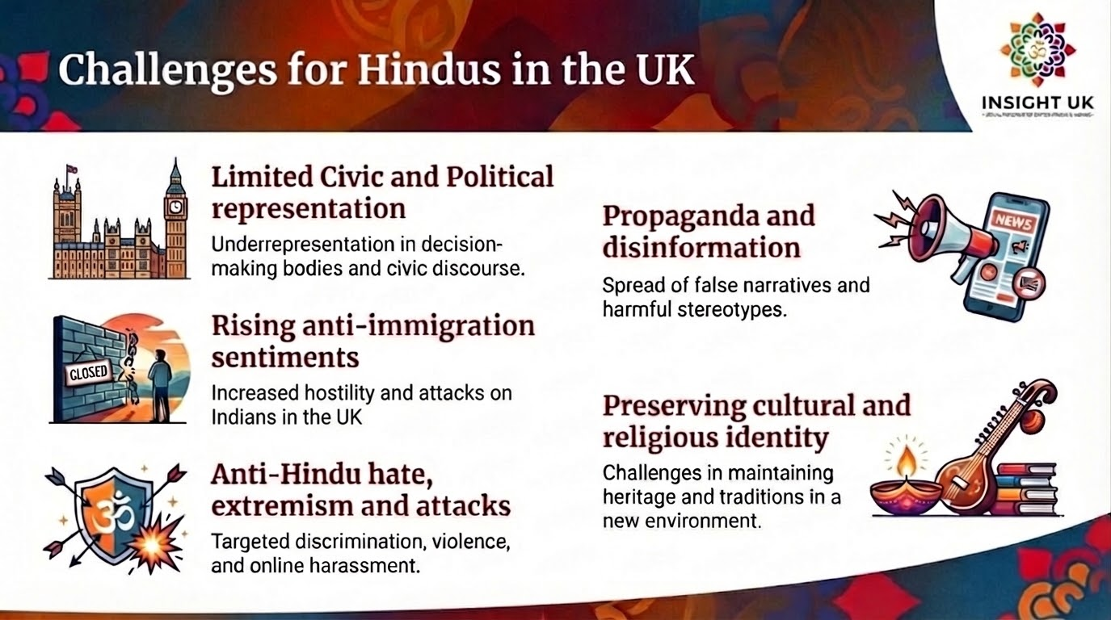

Slide 4
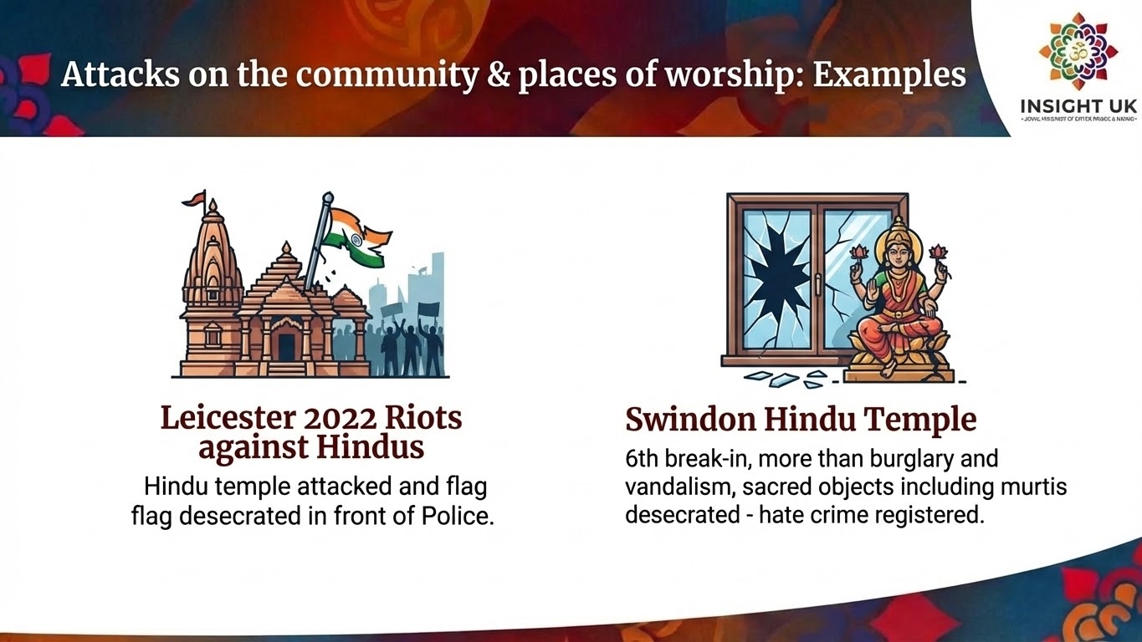
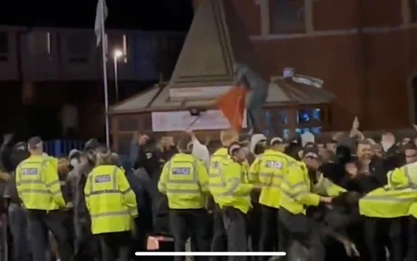
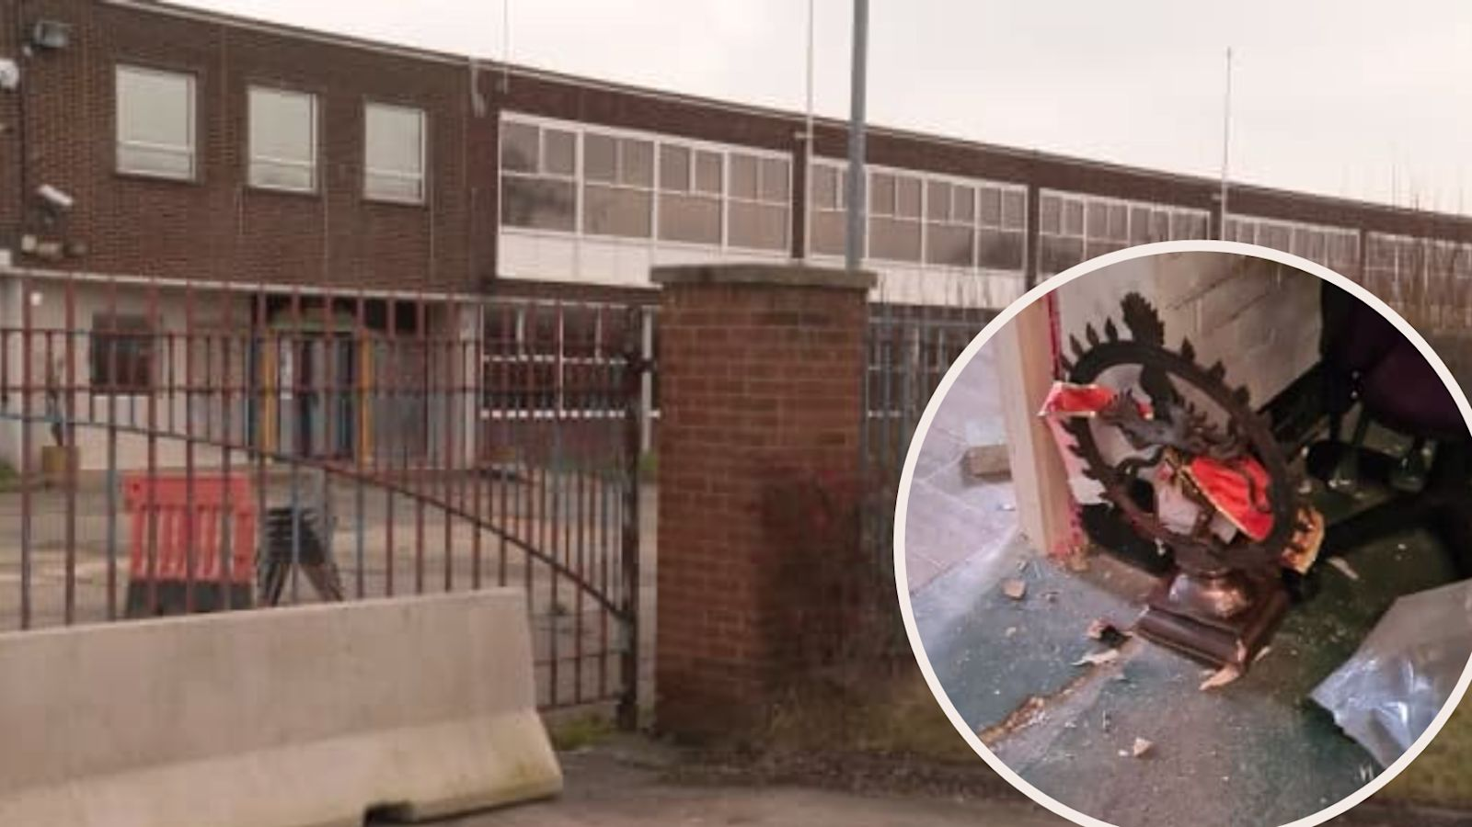
Leicester 2022 Riots against Hindu: Hindu temple attacked and flag desecrated in front of Police
Swindon Hindu Temple: 6th break-in, more than burglary and vandalism, sacred objects including murtis desecrated - hate crime registered

Slide 5
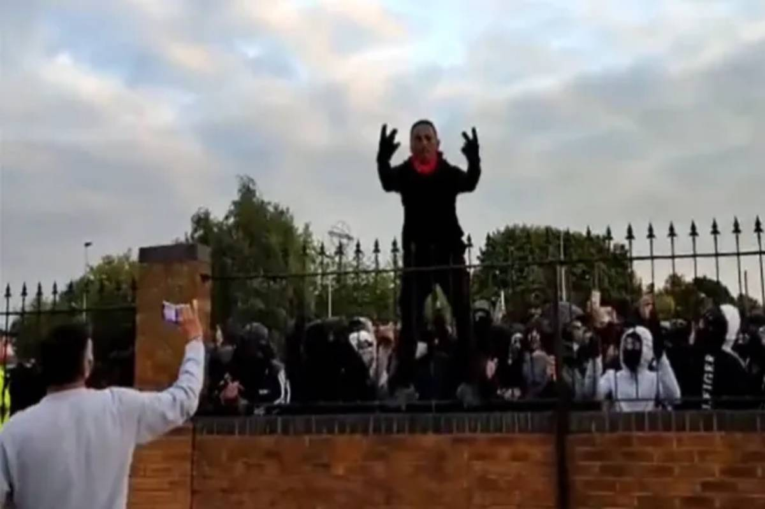
Sep 2022
200+ Islamists attacked Durga Bhawan Temple in Smethwick, Birmingham.
100+ WM Police officers protected the temple and community members inside.
One arrest made for possessing a knife.

Slide 6
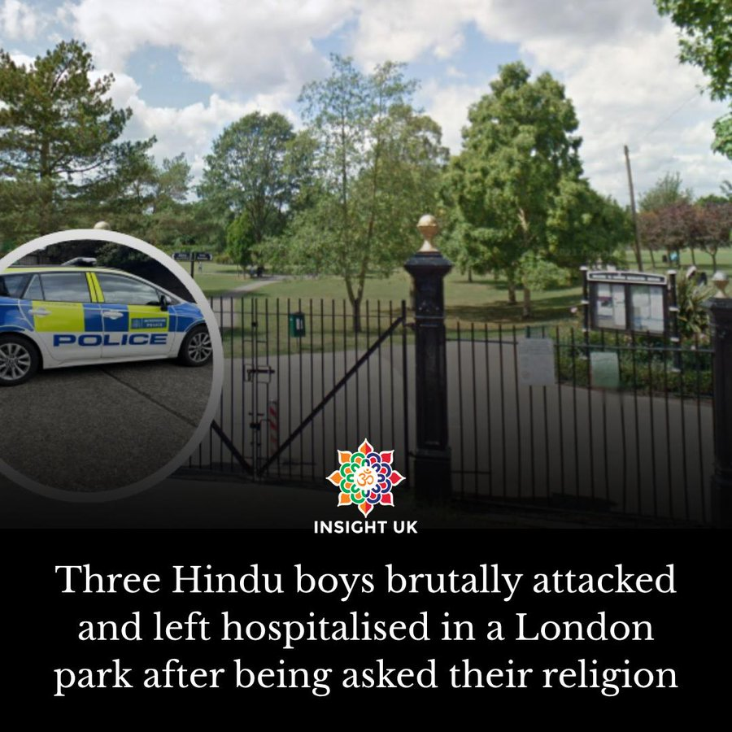
3 Hindu boys brutally attacked in Harrow - On Friday, 30th May 2025
Crime Report Number - 01/7556194/25
No arrests made by Police yet!

Slide 7
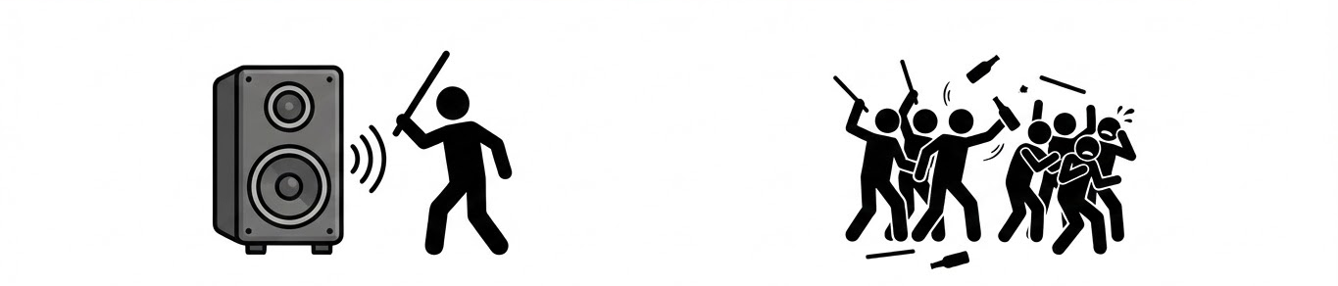
Hindus celebrating Holi attacked in Harrow on 3rd March 2026

Slide 8
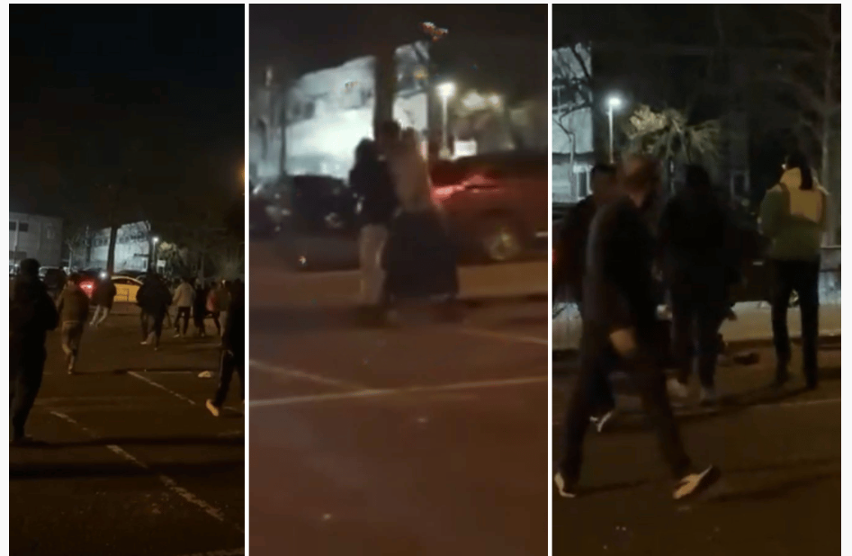
Siddhashram Shakti Centre: Around 8:35 pm, 3 youths,identified as a Muslim, arrived near the venue and began to disturb the sound system. They were reportedly carrying sticks and a sword.
Shortly afterward 10 minutes, from the roadside of the Mosque, a larger group of approximately 15–16 youths approached the vicinity, creating further disturbance and terror by throwing glass bottles, sticks and other objects.

Slide 9


Slide 10


Slide 11


Follow INSIGHT UK
Website: https://insightuk.org/
Social Media:
https://linktr.ee/insightuk
We are on X, Instagram, Facebook, Twitter, LinkedIn, TikTok, YouTube.

